Slide 1
Undergraduate Group 1 The SmartBall Wireless & Mobile Computing Final Project
Jacob Moran, Anthony Lozbin, Pritkumar Pagda

Slide 2
Presentation Overview
Background - The problems with current sports analytics systems.
SmartBall System Overview – Covering the system at a high level and then going more into detail in both software and hardware.
SmartBall Demo Video
Results from Experimentation
Conclusion – Discussing the limitations and future work on the SmartBall System

Slide 3
Problem Statement
Traditional sports analytical data gathering systems have various problems that our SmartBall system attempts to address.
Complexity – Across various professional sports, the systems in place to gather sports analytical data are very complex requiring many people and time to setup properly.
Cost – These traditional analytical systems rely heavily on expensive radar(s) placed around a playing field to obtain the data they need, introducing a large financial hurdle.
Immovability – These systems are usually immobile and set in specific places around a playing field, reducing the areas in which analytical data could be gathered.

Slide 4
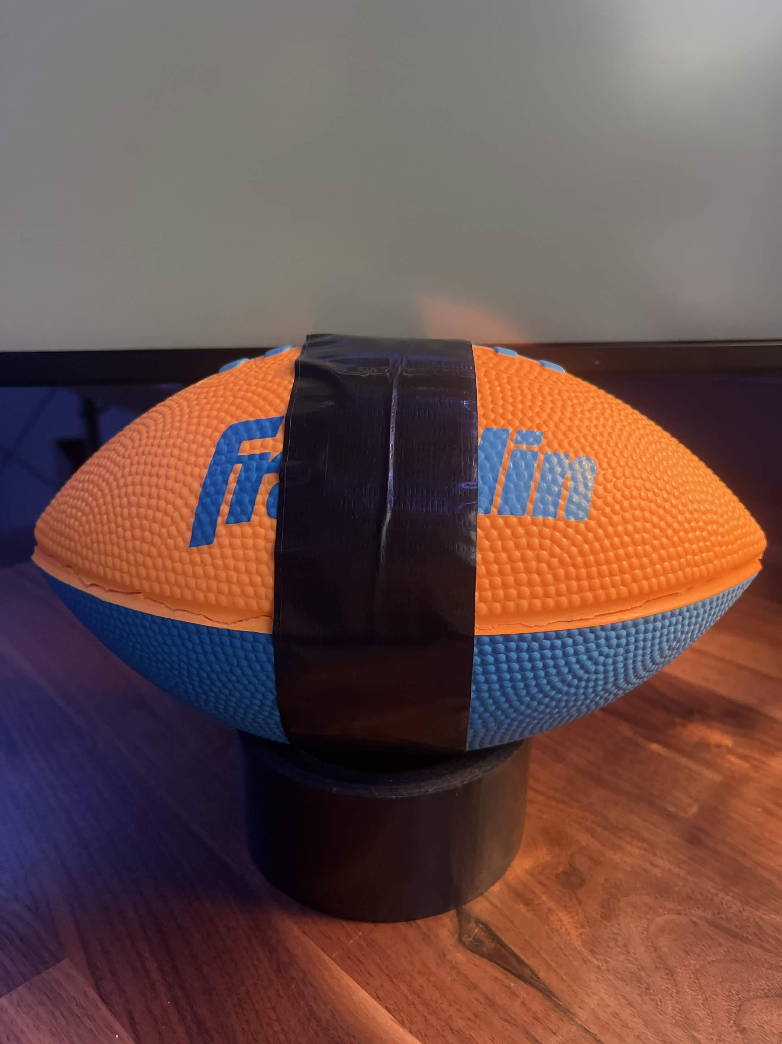
Our Solution – The SmartBall
The SmartBall is a sensor and communication-equipped game ball that obtains sports analytics data and communicates it to a mobile base station.
The SmartBall significantly reduces cost compared to traditional radar systems.
The SmartBall eliminates the immobility problems associated with traditional systems by connecting to any network where the base station is also connected.

Slide 5
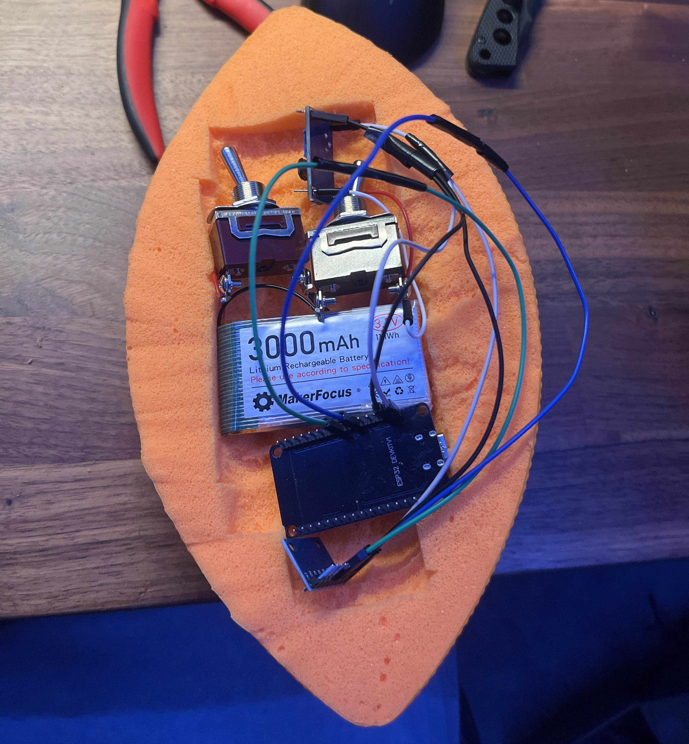
System Overview
The SmartBall system uses an ESP32 to read sensor data and communicate this data back to our base station over WiFi. It does this by sending the data via. UDP to port 4210 on our base station where the listener is running.
The listener is a Python program that waits for the ball to send throw data and then processes this data to return various analytical data points such as throw release time, throw release speed, peak acceleration, peak rotation, and expected throw distance. This data is available before the ball lands and is displayed in a command-line interface.
Image of SmartBall when testing component fitment inside of the ball.
Notes:
FOR ESP32 SECTION OF OVERVIEW :The SmartBall only sends sensor data whenever it detects a throw. This detection is based upon the event where enough force is applied on the ball and where enough spin is placed on the ball (>18 m/s^2 and >5 rad/s). FOR LISTENER SECTION OF OVERVIEW : The listener also logs all data it gathers from each throw automatically into a CSV file where it can be analyzed later as historical data.

Slide 6
Listener – Code Overview
Waits for incoming motion data over UDP
Timestamp
Acceleration (x, y, and z-axis from accelerometer)
Angular velocity (x, y, and z-axis from gyroscope)
One sample every 5 ms → 200 Hz
Processes the throw data
Release time (sec)
Release speed (m/s)
Peak acceleration (m/s^2)
Peak rotational speed (rad/sec)
Expected distance traveled (m)
Throw strength classification

Slide 7
Listener – Process Throw
Checks sample count; ensure enough data for throw analysis
Converts samples to arrays
Convert timestamps to seconds → estimate sampling interval
Compute acceleration and rotational magnitudes
Estimates gravity direction → remove gravity from acceleration
Detects and validates moment of release
Integrates acceleration → initial velocity
Computes estimated throw distance
Classifies throw strength
Prints results, logs to CSV file
Notes:
First, the sample count is checked to ensure that there is enough data present in the received packets for computations.
Then the timestamp, accelerometer, and gyroscope values are converted to array format.
The timestamp is analyzed in seconds to estimate the duration of the throw sample.
The motion magnitudes for acceleration and rotation are computed to extract the peak acceleration and peak rotation.
Pre-throw stability (in regards to whether the ball was rotating before release) and gravity magnitude and direction are computed from the packets preceding those sent after release. A warning is issued for poor stability prior to release, and gravitational force is subtracted from the ball acceleration during the throw.
The moment of release is detected in the first sustained drop in acceleration magnitude to below about 65% of the force of gravity. The ball has transitioned form user-applied force to freefall.
The release timing is validated to reject throws with unreasonable release position and timing. A bad status is issued for throws where the release occurs within the calibration window (~first 0.15 seconds), within the last 10% of received packets, or if the release happens after the first 0.95 seconds (this means that the system may have recorded an unreliable sample).
The release speed is computed by taking the magnitude of the velocity vector, and validated to account for unreasonable values.
The throw distance is estimated using the calibrated quadratic model based on speed.
Using the predetermined thresholds, we classify the throw as weak, medium or strong. We print the results to the output and log them in a CSV file.

Slide 8
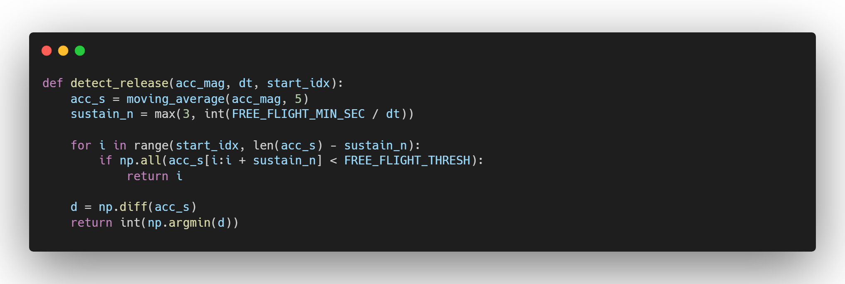
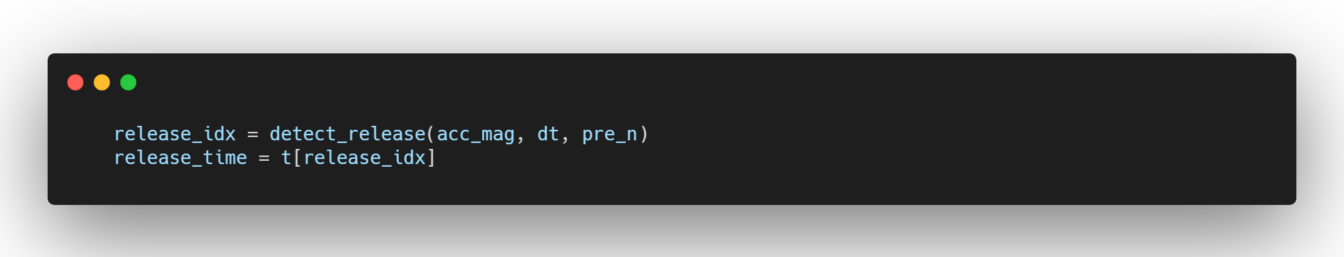
Listener – Detect Release Moment
Notes:
First we smooth the acceleration by averaging all adjacent packets.
Then we convert the time threshold for freefall acceleration into an exact number of samples.
The loop finds the first low acceleration packet, and checks whether low acceleration is sustained in following packets, this tells us if the ball is in freefall.
The difference between adjacent samples is computed, and the sharpest drop in acceleration is returned as the detected release point.
Then the sample corresponding to that release point is found and its timestamp is taken as the release time.

Slide 9
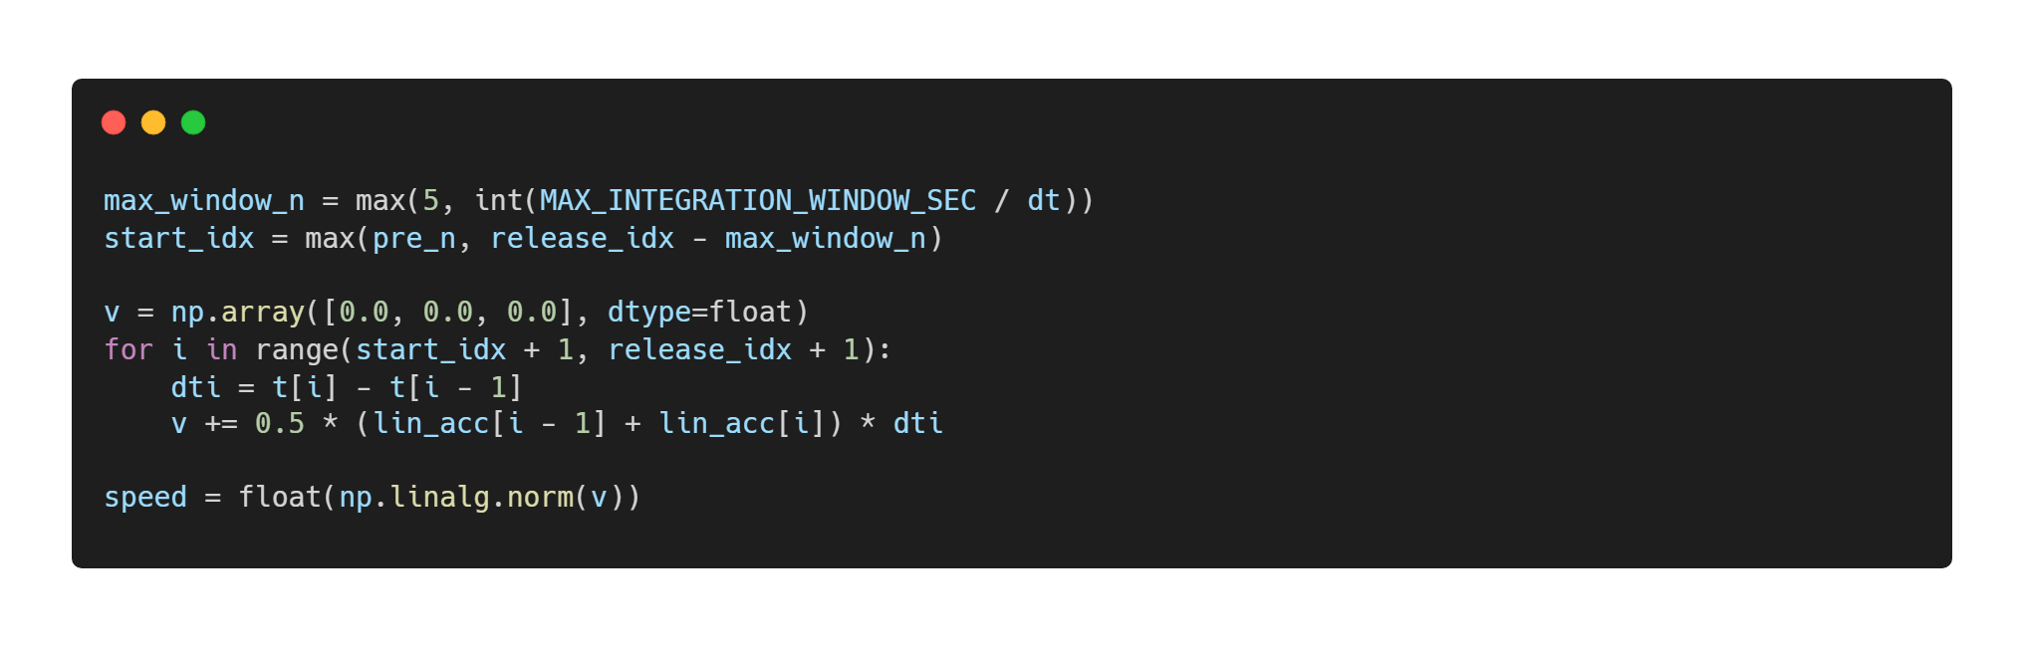
Listener – Compute Release Speed
Notes:
First we convert the integration window from seconds to the number of corresponding samples and set the starting index.
We initialize the velocity vector to zero.
The loop runs across samples just before release to compute the time taken, and updates the velocity. The trapezoidal numerical integration averages two neighboring samples for better accuracy.
Finally we compute the magnitude of the resulting velocity vector to get the speed at release.

Slide 10
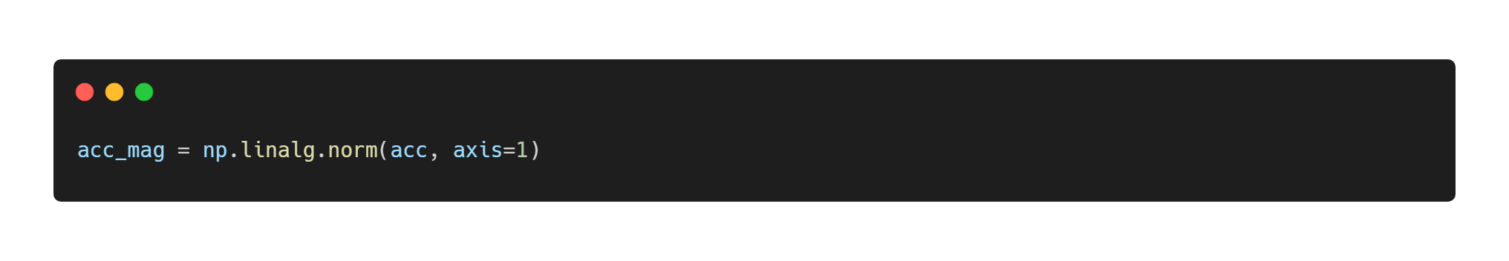
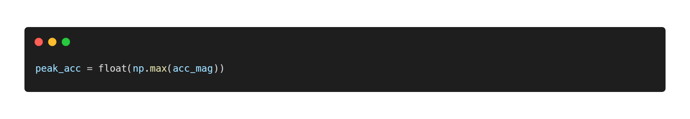
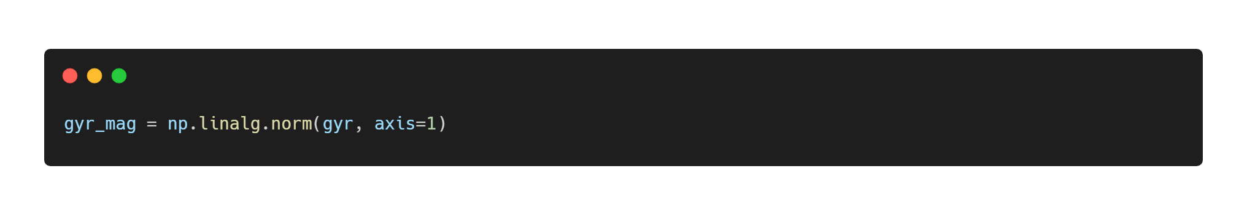

Listener – Peak Acceleration And Rotation Extraction
Notes:
For both acceleration and rotation: values from all three axes are combined, and the largest vector is taken.

Slide 11
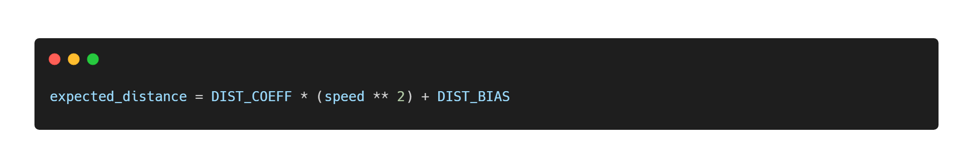
Listener – Expected Travel Distance
Notes:
Our calibrated distance prediction.

Slide 12
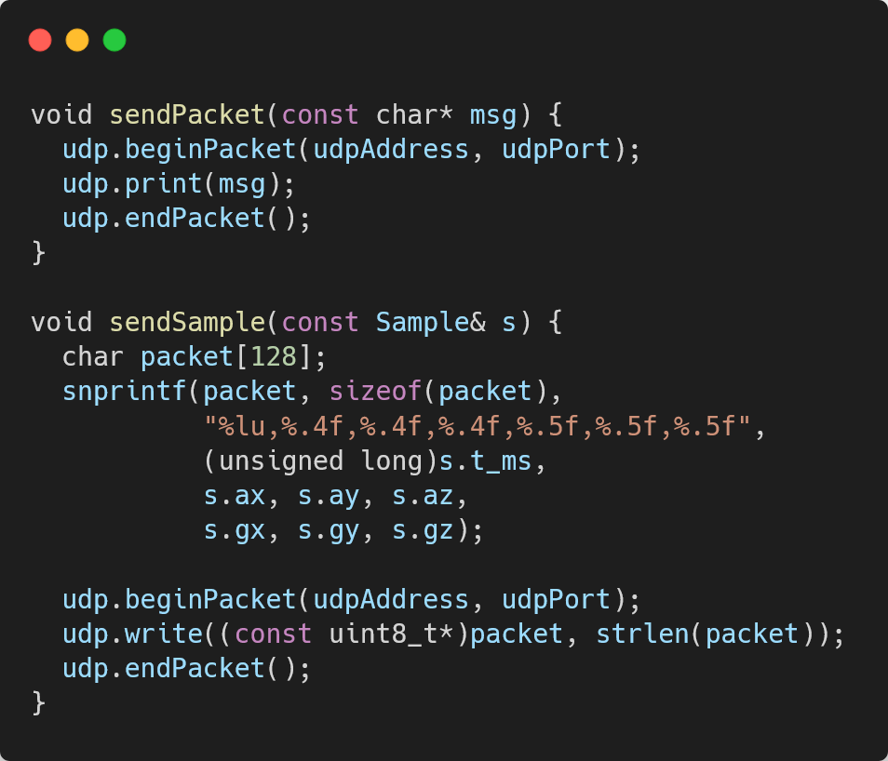
ESP32 – UDP Streaming
The image shows how the ESP32 communicates the sensor data over Wi-Fi.
The network information is hard-coded within the ESP32 code. This information consists of the SSID, password, and IP address of the listener device.
It communicates over Wi-Fi using UDP. The reason for using UDP over TCP is that UDP is lightweight and quick.
TCP requires a handshake and cares about packet loss where UDP does not.
If a packet of data is lost, it is still possible to perform calculations on the remaining data to output some analytical data.

Slide 13
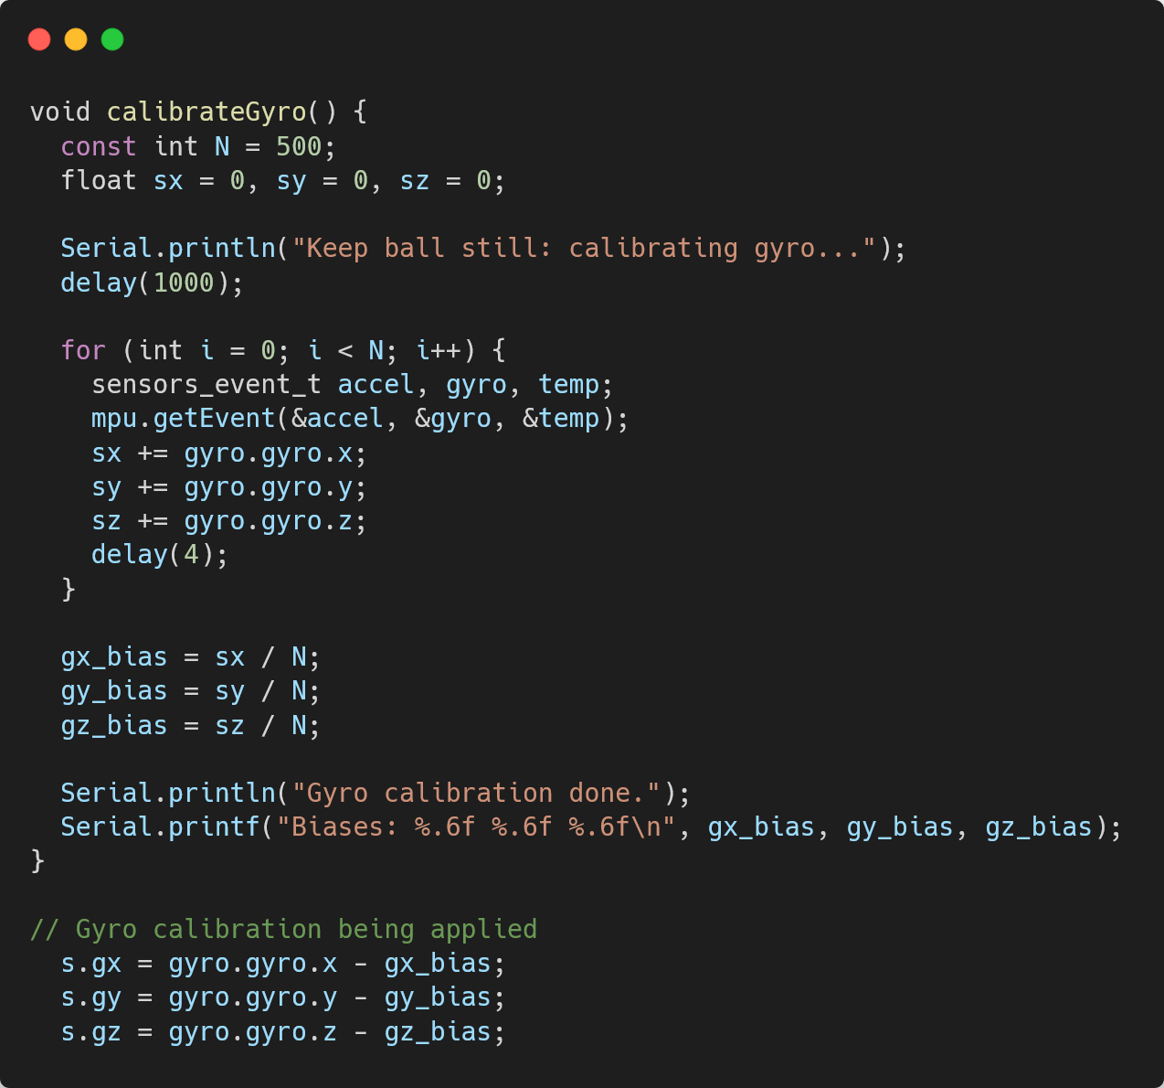
ESP32 – Auto-Calibration
The figure shown in this slide is the code snippet of the ESP32 auto-calibrating the Gyroscope of the MPU6050.
Before the system is ready for use (just after being turned on), the system calibrates the gyroscope by averaging readings while the ball is still.
This obtains sensor bias which we can remove from the active readings to improve the quality of motion data before being transmitted.

Slide 14
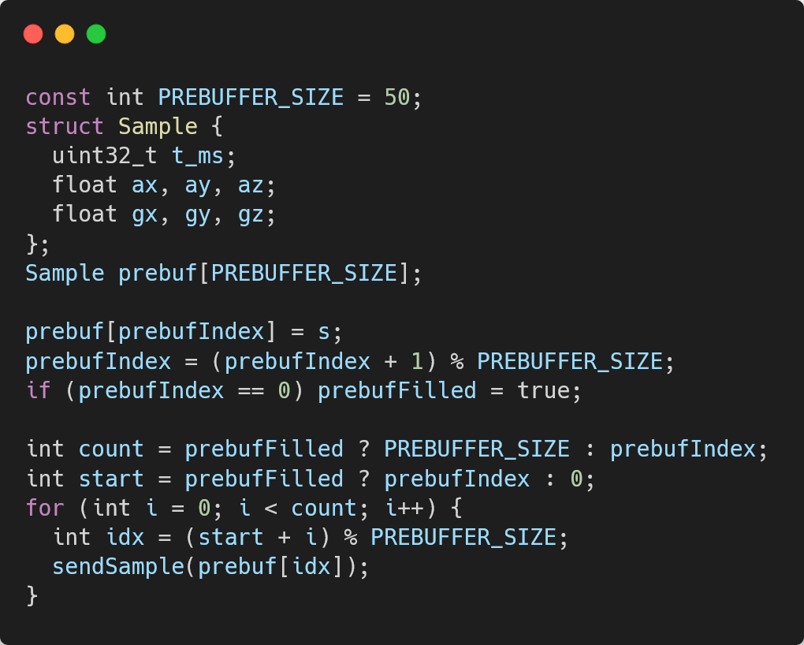
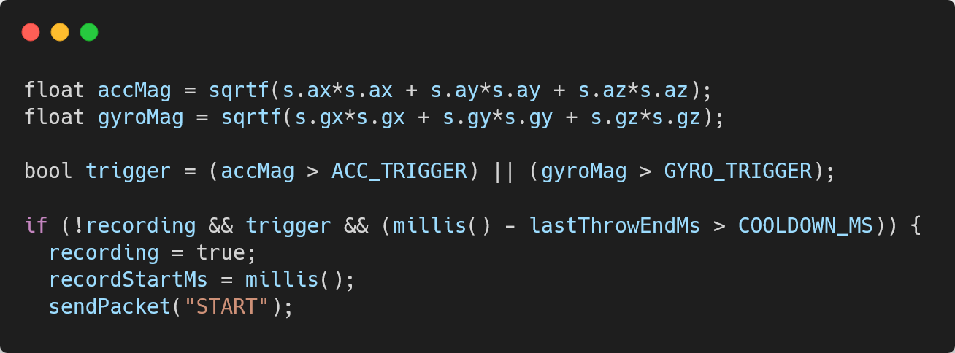
ESP32 – Pre-Roll Buffer & Throw Detection
The first image relates to the pre-roll buffer. This circular pre-roll buffer keeps a short history of recent motion samples.
As a result, when a throw is detected, it sends the data just before and just after the trigger. This preserves the data from the beginning of the throw which is crucial for sports analytics.
The second image shows how the ESP32 determines that a throw has occurred.
The ESP32 checks total acceleration and angular velocity such that when either crosses a threshold, the system determines it as a throw "event" and begins recording. There is also a cooldown period so that the system would not re-trigger when the ball was picked up after a throw.

Slide 15
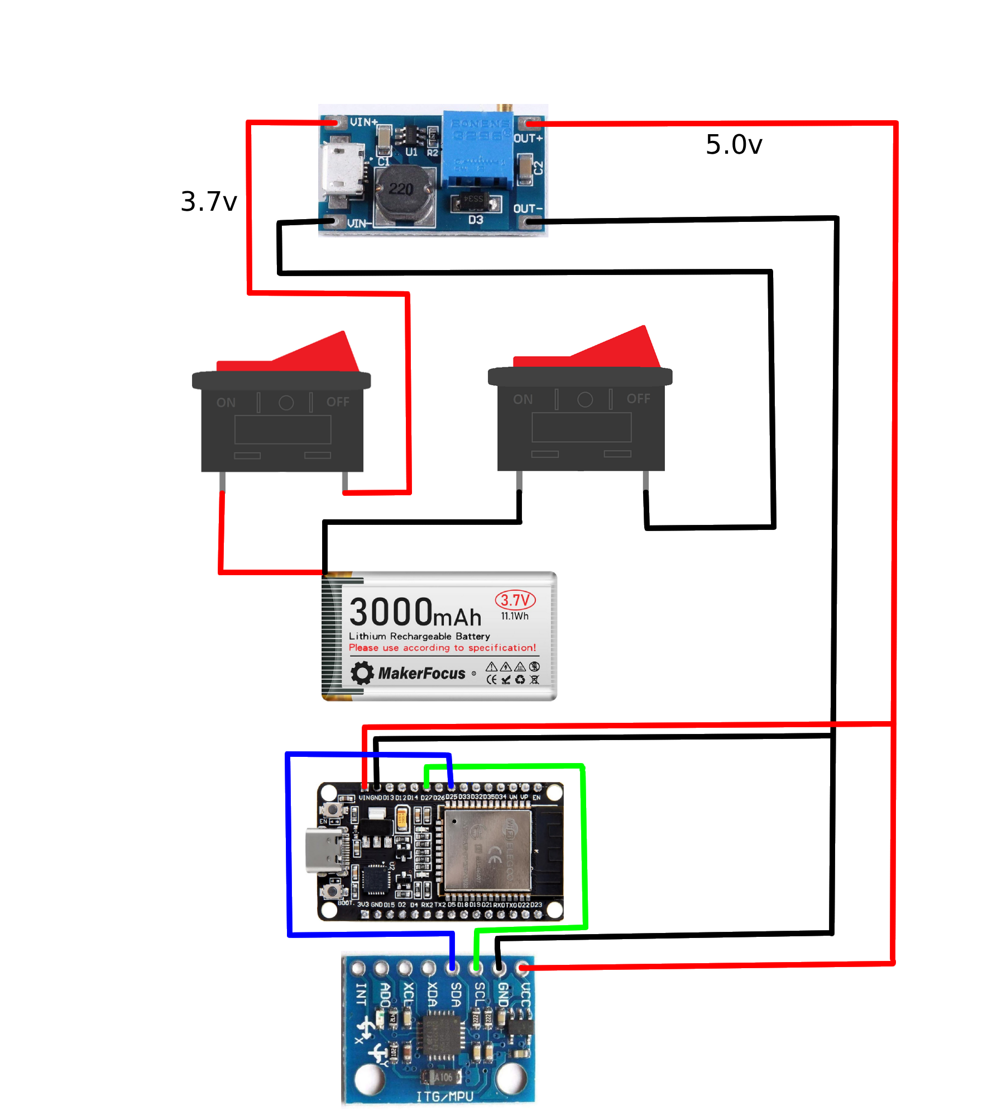
Hardware Overview
The system relies upon an ESP32 for reading sensor data and communicating this data via WiFi to the base station.
The sensor gathering the analytical data is a MPU6050 6-axis Accelerometer and Gyroscope.
Both the ESP32 and MPU6050 require a 5V input which is supplied by the MT3608 DC-DC Boost Converter.
The MT3608 receives 3.7v from our 3000 mAh LiPo battery.
The batteries positive and negative terminals are both switched to be able to turn off the system.
The battery is charged outside of the ball via a TP4056 5V 1A USB-C Battery Charger.
Notes:
The reason why the negative terminal is switched is to allow for simple removal of the battery from the circuit within the ball to be able to charge it. The TP4056 requires a soldered connection which would require soldering and de-soldering each time a charge is needed the switched-negative terminal fixes this issue.

Slide 16
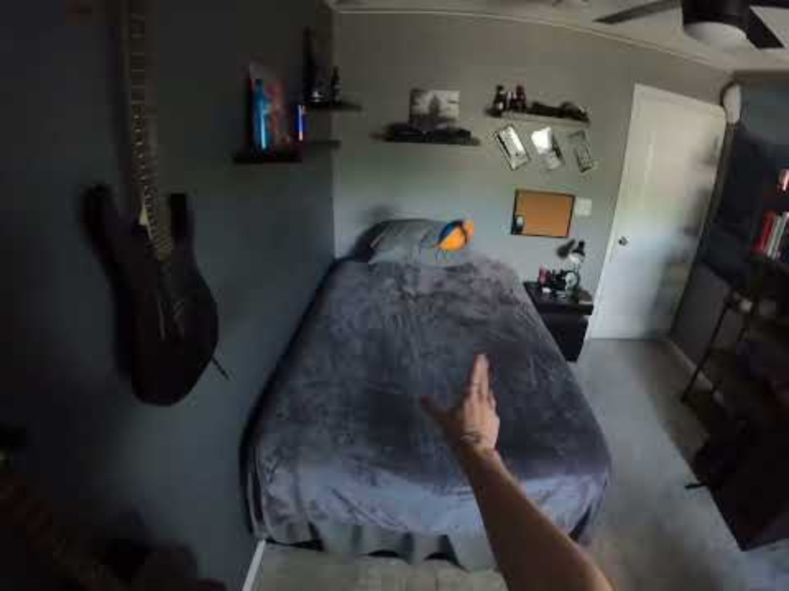
The SmartBall Demo

Slide 17
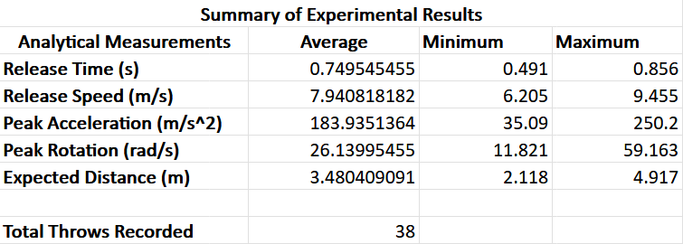
Experimentation Results
The results above were gathered from 38 different recorded throws all in the same controlled environment. Invalid throws were filtered by the listener and excluded from analysis.
Environment – The experimentation environment consists of throwing the ball from the same location to the same location 11ft or 3.35m away.
Key Result – The system estimated throw distance within ~4% error in our controlled environment.
Notes:
We tested the system with 38 valid throws in a controlled setup. On average, the estimated distance was within about 3.7% of the true distance. This shows that our calibrated velocity-based model produced consistent and accurate results in a repeatable environment.

Slide 18
Limitations
The SmartBall system in its current form is just a prototype and thus has various critical limitations.
Size & Weight – The SmartBall system is currently large and adds weight to the game ball. This reduces its applicability in certain sports that have smaller balls. The weight increase also changes how the ball acts in motion compared to a traditional ball.
Pre-Configuration – The system requires that certain information is flashed to the ESP32 beforehand, reducing its practicality.
Charging – The battery used by the system must be removed to be able to be charged which significantly reduces its practicality.
Wi-Fi Connection – The system relies upon a stable and pre-existing Wi-Fi connection across the areas where it is used.
Controlled Environment – The system currently requires a controlled environment where the listener is tuned to this environment to receive accurate results.
Operates in the Sensor Frame – The SmartBall currently only knows information about itself and not about the outside world, reducing its practicality and feature set.

Slide 19
Future Work
The SmartBall prototype demonstrates feasibility, but several improvements can significantly enhance accuracy and usability:
Operate in the Global Frame – We can add a magnetometer to allow the ball to better determine expected distance and even calculate trajectories.
Smaller Components – We can reduce the footprint of the system by switching to a Mini ESP32, smaller battery, and smaller switches. We could design our own PCB that contains all the components to reduce the footprint even more.
Onboard Charging – We can use the same TP4056 charger onboard to allow for the ball to never have to be disassembled to be charged.
Communication Robustness – Instead of relying upon a pre-existing Wi-Fi network, we can utilize the ESP32's capability of operating in AP mode in areas with no Wi-Fi. We can also utilize the ESP32's Long Range mode to extend how far the ball can communicate when Wi-Fi is present (~1km).
Wireless Configuration – We can use the wireless capabilities (ex. bluetooth) of the ESP32 to configure the Wi-Fi connection parameters for sensor data communication.

Slide 20
Conclusion
The SmartBall system is a low-cost, portable alternative to traditional sports analytics systems.
It provides real-time throw detection and wireless data transmission.
The system extracts key metrics: release speed, acceleration, rotation, distance
The SmartBall was shown to have a ~4% distance estimation error in controlled environment.
The system demonstrates feasibility of embedded, sensor-based sports analytics.
The system also provides a strong foundation for future improvements (global tracking, miniaturization).
Notes:
The SmartBall demonstrates that low-cost embedded hardware can be used to capture and analyze sports motion data in real time. While full trajectory estimation is limited, our calibrated model achieved about 4% distance accuracy in a controlled setup. This shows strong potential for portable and accessible sports analytics systems moving forward.

Slide 21
Thank you. Questions?

